Slide 1

How data will impact your agency relationships
Chris Walton
20th February 2014

Slide 2
SEX

Slide 3

“The sexiest job for the next ten years will be statistician…”
Hal Varian
Chief Economist, Google
Speaking in 2009

Slide 4

What have you asked me?
What is data and is it as important as everyone says?
How will data impact your agency relationships?
How do I see the evolution of consumer insights as data analysis becomes more predominant?
How will this impact communications and channel planning?
How will media companies need to adapt to take advantage of the new data driven world?

Slide 5
What have you asked me?
What is data and is it as important as everyone says?
How will data impact your agency relationships?
How do I see the evolution of consumer insights as data analysis becomes more predominant?
How will this impact communications and channel planning?
How will media companies need to adapt to take advantage of the new data driven world?

Slide 6
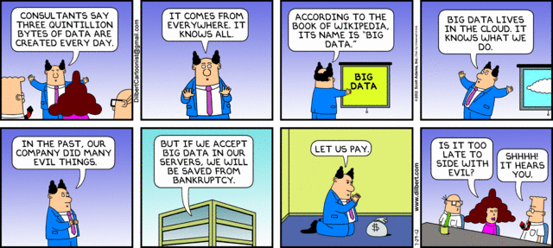
Big Data

Slide 7
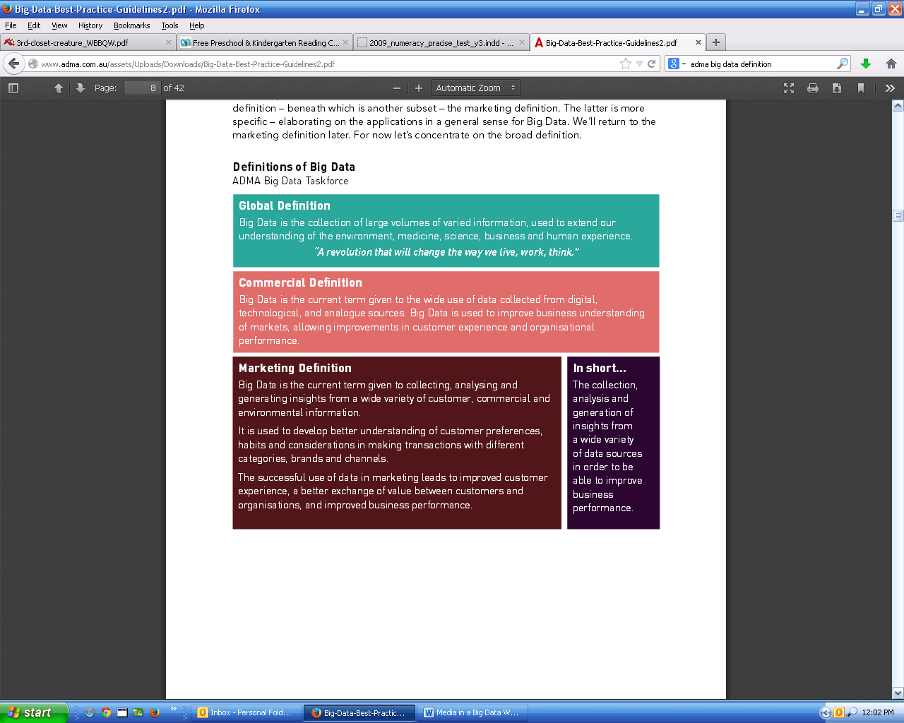
Big Data
“The
collection, analysis and generation of insights from a wide variety of data sources in order to be able to improve business performance”
Source: ADMA “Best Practice Guideline: Big Data”, 2013

Slide 8
Big Data
‘Vital’ for current and future decision making
88%
‘Vital’ within three
years
93%
Source: WFA Survey, quoted in ‘Marketers admit Big Data Struggle’, WARC, 4/2/14

Slide 9
What have you asked me?
What is data and is it as important as everyone says?
How will data impact your agency relationships?
How do I see the evolution of consumer insights as data analysis becomes more predominant?
How will this impact communications and channel planning?
How will media companies need to adapt to take advantage of the new data driven world?

Slide 10

1. Marketers will not need Media Agencies

Slide 11





Slide 12
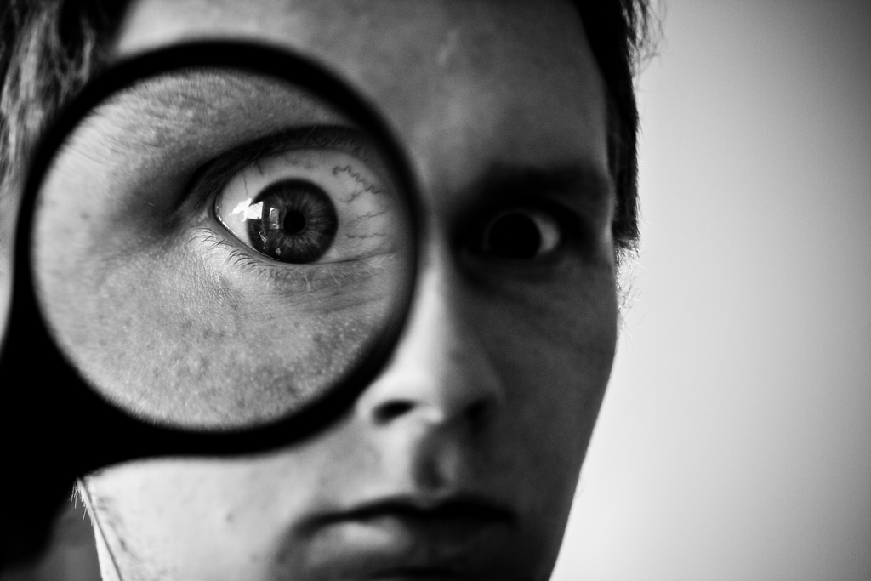
2. Trust & transparency will be much more important
“Welcome to the Internet of Thingies”
Alexis C. Madrigal
The Atlantic
12/12/13
“Meet the Most Suspect Publishers on the web”
Mike Shields
Adweek
19/3/13

Slide 13

3. Collaboration will improve

Slide 14

4. Negotiation size will matter less

Slide 15
“Personalization is key for the beauty omni-channel strategy…”
“…I think with personalisation, and building one-to-one relationships, it’s actually exciting, because the technology has finally caught up with what we’ve all been talking about, saying personalisation is important, we want it to be dynamic, we want it to be real-time.”
Rachael Johnson
VP Digital Strategy & E-Commerce
L’Oreal Luxe
Source: Luxury Daily (NY), January 2014

Slide 16
Being a C & T beats being a Big N
Content creator
Connector
Collaborator
Technology
developer
Technology user
+
Big Negotiatior

Slide 17
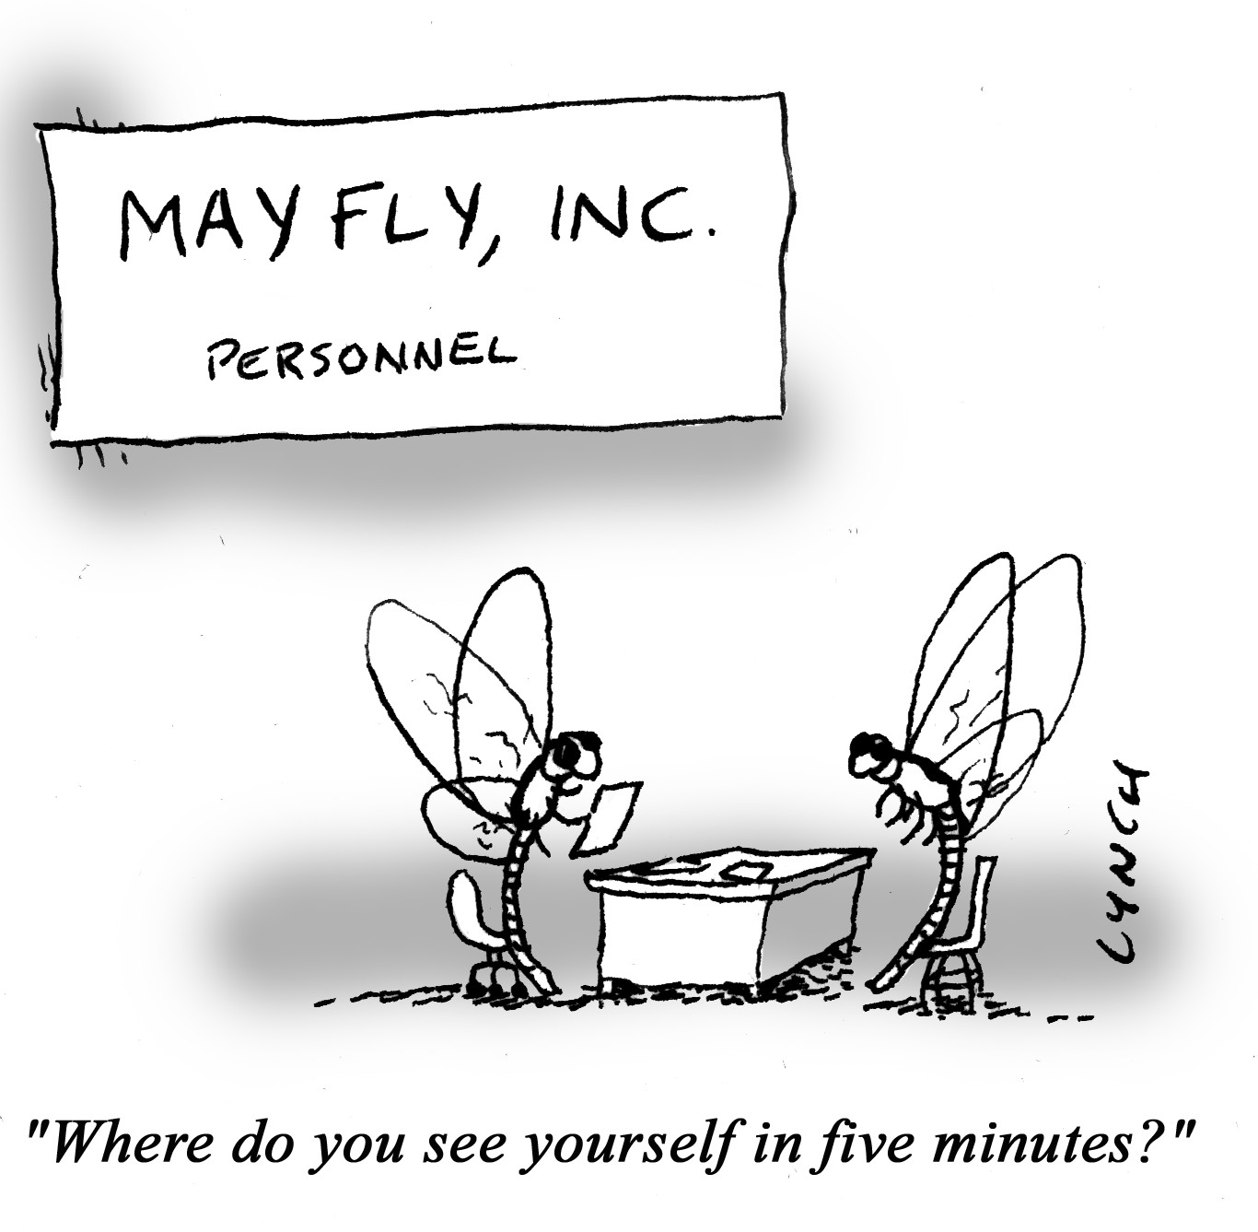
5. Media agencies will employ different talent

Slide 18


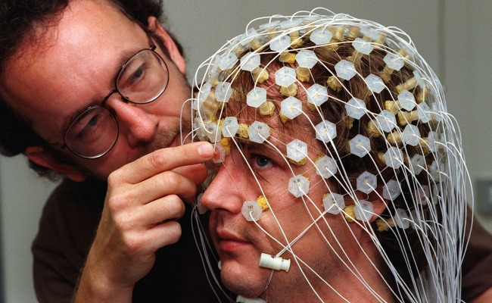

Slide 19
What have you asked me?
What is data and is it as important as everyone says?
How will data impact your agency relationships?
How do I see the evolution of consumer insights as data analysis becomes more predominant?
How will this impact communications and channel planning?
How will media companies need to adapt to take advantage of the new data driven world?

Slide 20

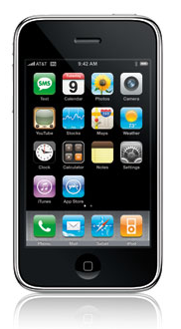

1998
2004
2009

Slide 21
Big Data
Currently unprepared
to take advantage
74%
‘Vital’ for current and future decision making
88%
‘Vital’ within three
years
93%
Source: WFA Survey, quoted in ‘Marketers admit Big Data Struggle’, WARC, 4 /2/14

Slide 22
“The sexiest job for the next ten years will be statistician…”
Hal Varian
Chief Economist, Google
“…but statisticians are just a part of it…You also want to be able to visualize data, communicate it and utilize it effectively ”

Slide 23

Setting the agenda – Your Big Data Strategy
“Companies that distill and translate data into actionable insights are those who will lead.”
Mark Toon
KPMG
“Not all data that is valuable is internal and proprietary.”
McKinsey Quarterly
January 2014
Forget about Big Data
What data do you have access to?
Who could your partners be?
What is the case for investment?

Slide 24
What have you asked me?
What is data and is it as important as everyone says?
How will data impact your agency relationships?
How do I see the evolution of consumer insights as data analysis becomes more predominant?
How will this impact communications and channel planning?
How will media companies need to adapt to take advantage of the new data driven world?

Slide 25
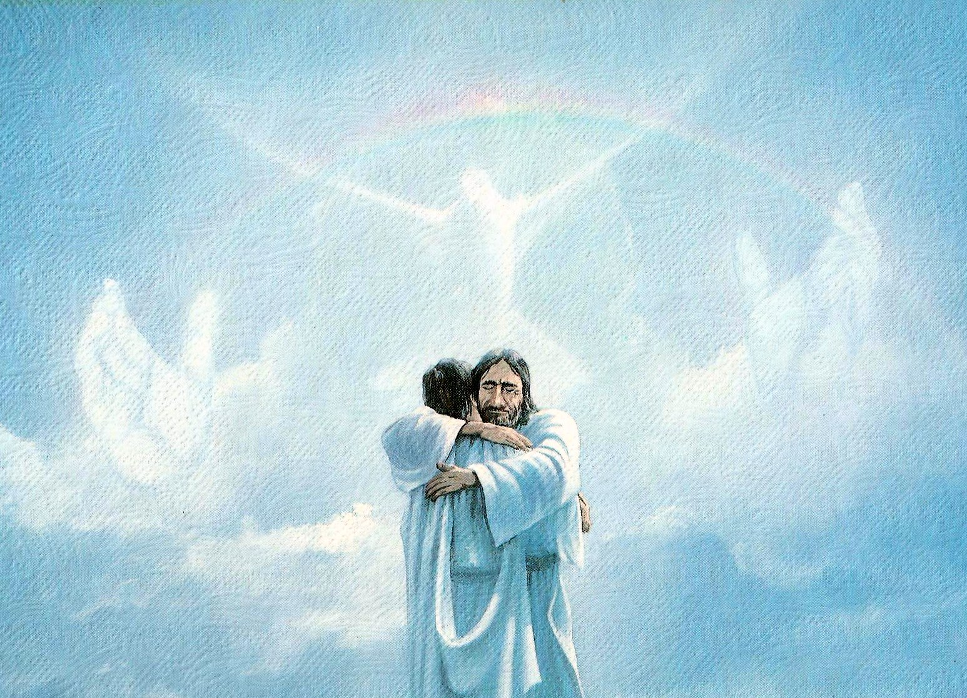
A final thought from W Edwards Dening
“In God we trust…
…All others must bring data.”

Slide 26
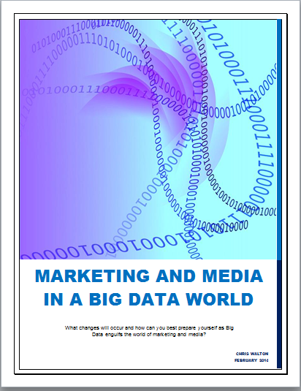
Interested to read more?
+61 423 797 523
@chriswalton123
cdwalton@bigpond.net.au
au.linkedin.com/in/chriswalton1/

