Slide 1
Unlocking the strategic potential of the MPA
Strategic development for 2013

Slide 2
Grow magazines share of advertising adspend by 1 percentage point*
* ASA measured adspend

Slide 3
The Process
Redefine our organisational identity
Develop a single organising thought that drives all activity to 2015
Distil our messaging
Build the tactical roadmap that delivers the vision

Slide 4
Objective
We believe the MPA can provide the strategic leadership to drive revenue growth - we have the freedom to set the vision.

Slide 5
The Problem
Magazines are challenged as never before.
The relevancy and vitality of magazines are in question.
Consumers behaviour has evolved and advertisers are struggling to keep up.

Slide 6
The Challenge
How can we change the conversation, so that the tide of negativity is abated and pushed out?
Our End Point
Our vision needs to demonstrate that magazines are continually evolving to overcome perceptions that we are lacking innovation and progressiveness.

Slide 7
The Insight
“Today, the MPA has been seen as an inward looking administrative body protecting its own interests”.
There is a lack of clarity in our messaging.
And we have had little presence with advertisers.
Source: Agency Verbatims

Slide 8
The MPA Today
Because of this, the lines of responsibility for the MPA are unclear:
MPA
Sponsors
Consumers
Advertisers
Publishers
Sales Reps

Slide 9
The MPA Tomorrow
A clear role to play to drive ad spend:
The frontline
Advertisers
Publishers
The MPA
Sponsors

Slide 10
The MPA Tomorrow
A clear role to play to drive ad spend:
The frontline
Providing tools/armour for the frontline
Advertisers
Publishers
The MPA
Sponsors

Slide 11
The MPA Tomorrow
A clear role to play to drive ad spend:
The frontline
Advertisers
Being accountable and unbiased in our representation of our members
Publishers
The MPA
Sponsors

Slide 12
The MPA Tomorrow
A clear role to play to drive ad spend:
The frontline
Giving them reasons to say yes
Advertisers
Publishers
The MPA
Sponsors

Slide 13
Evolving the Conversation
As an industry we have to commit to evolving the way we talk about ourselves.
Continue the evolution from solely commoditised measurement to meaningful insights
Move from ‘selling pages’ to ‘selling solutions’;
Move from ‘defending our patch’ to inspiring great work.

Slide 14
5 Things We’ve Learnt
#1 Evolution does not mean extinction
Fostered by technology, readers are reading more magazines across both digital and print platforms
“..rather than abandoning print for digital, consumers exposed to digital editions are expanding their overall print reading repertoire across platforms.
68% have read a magazine on a tablet that they have not previously read in print.
52% have a magazine and/or newspaper repertoire …wider than before they owned a tablet”
Key outtake: There is no ‘substitution-effect’. The market is growing,
not contracting
Source: PPA TAP report 2012

Slide 15
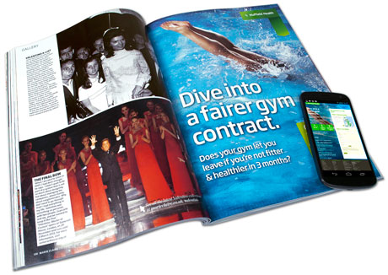
5 Things We’ve Learnt
#2 Adapt and adopt
Print advertising is evolving with the addition of multi-media technology.
Eg. marie claire has just launched the UK’s first NFC enabled ad.
New technology will increase magazines appeal to a wider range of advertisers eg. Retailers.
Key outtake: There are ongoing opportunities to innovate

Slide 16
5 Things We’ve Learnt
#3 Keep your friends close and your enemies closer
Magazines make advertising campaigns far more effective, either when used alone, or in conjunction with other media.
“..magazines showed a higher average ROI than any other media channel involved, including television, internet and newspapers”
“61% of respondents agreed that they were more likely to remember a brand after seeing advertising in magazines as well as TV”
Key outtake: Magazines have been and will continue to be a highly effective advertising channel
Source: PPA Magonomics 2012, FIPP Proof of Performance 2012

Slide 17

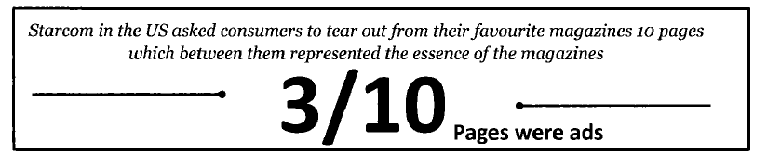
5 Things We’ve Learnt
#4 If it ain’t broke….
The world’s most covetable brands are still using magazines to evolve their brands to connect with the high net worth market.
Key outtake: Brands still need us
Source: FIPP Proof of Performance 2012

Slide 18
5 Things We’ve Learnt
#5 The whole is greater than the sum of it’s parts
Magazine brands can embrace communities of interest, and can evolve to remain relevant outside our core print vehicle.
The benefit for advertisers is that they can reach and engage communities of interest across all magazine brand touchpoints.
Key outtake: Only channel where the brand lives beyond the medium into the mindset of consumers
Source: FIPP Proof of Performance 2012

Slide 19

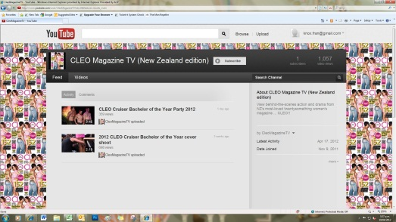
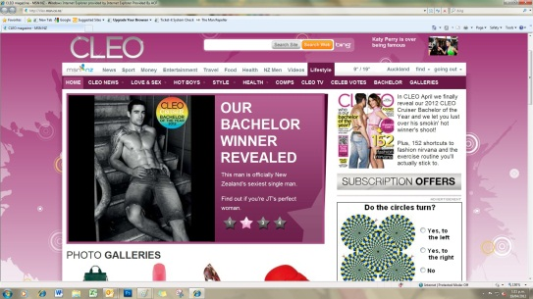



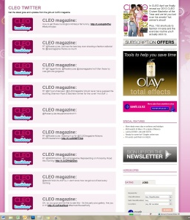

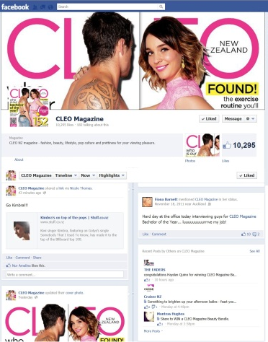






Key Statistics
Readership: 154,000
Circulation: 12,556
Core Target: Females 18-29
CLEO Channel on You Tube
The portal for all CLEO-related videos; i.e. Bachelor Cover Shoot and Party etc.
cleo.co.nz
60,000 – 70,000 visitors per month.
Bachelor Season (Feb-April) 1.2 million page views in 2012
CLEO Video
Editor presents new products
CLEO Magazine on Twitter
1,939 followers. Quick story links and gossip
CLEO Facebook
13,270 likes
Frequent celebrity & fashion updates. Behind-the-scenes from the CLEO office, and giveaways
QR Codes
Bring your brand to life with video, website or coupons
CLEO Magazine
154,000 readers
12,556 average issue sales
CLEO Events
Bachelor of the Year Party leveraging through Ticketek – 650 attendees
CLEO Magazine
130,000 readers
13,007 average issue sales
Notes:
Cleo is so much more than just a magazine - we continue to deliver cross platform campaigns that achieve impressive results. Such as last month Cleo bachelor - 650 attended the party, bachelor section @ Cleo.co.NZ delivered 1.2 million page views, bachelor behind the scenes on you tube - one bachelor received more than 17,000 views plus not to mention the 1000s of votes.
We seeing a good response with QR codes - partnering with sponsors to bring the brands to life. Such as with our recent bachelor cover & Jockey
There's Cleo glam cam where the Cleo editorial show off your clients product in a ‘behind the scenes’ situation from the CLEO office. Hosted on You Tube
Plus there’s Cleo street style app where by Cleo lovers upload their style pic and editorial pick a winner. Sponsorship opportunities for this and coming in July

Slide 20
Single Organising Thought
These core insights are centred around the fact that magazines no longer operate in isolation – driven by how people are changing their media habits.
‘Print alone’ is no longer enough - we are proposing a vision which will future proof the industry in the face of shrinking budgets and rapid technology.
This has led us to a vision that will underpin all of the MPAs activity through the next 3 years.

Slide 21
Strategic vision for the MPA:
Engaging people beyond the page

Slide 22
Redefining the MPA
Engaging people beyond the page
Inspire advertisers by staying ahead of shifting media trends and consumers use of media
Champion the industry to reposition our members as integrated innovators
Support our frontline with the tools to drive solid commercial results
+
+

Slide 23
Redefining the MPA
Beyond the page talks directly to our role:
To demonstrate to advertisers that the reach of our media goes further than any other in isolation.

Slide 24
4 Strategic Pillars
2013 KPIs DRIVING THE MPA FORWARD

Slide 25
4 Strategic Pillars
KPI – PROVE EFFECTIVENESS
Move from talking commoditised measurement to meaningful insights. In order to do this we need to continue to evolve our focus from Readership to Effectiveness.
HOW WE’LL SAY IT
“The world’s biggest and most successful campaigns have magazines at the heart”.
DELIVERABLES
Effectiveness based research EFFIES Case Studies Monthly Email Programme Develop content for MPA Portal – ‘Nickable Stuff’

Slide 26
4 Strategic Pillars
KPI – FOSTER INSPIRATION
Demonstrate innovation throughout magazine brand communities.
HOW WE’LL SAY IT
“Here’s the next new thing in media engagement.”
DELIVERABLES
PR Thought Leadership Industry Awards Monthly email programme Build Editor Profiles /New Season Launches Embed magazines into digital media schedules

Slide 27
4 Strategic Pillars
KPI – DIRECT COMMERCIAL APPLICATION
Ground the vision in a commercial reality – giving tools to support the frontline.
HOW WE’LL SAY IT
Getting advertisers to say yes.
DELIVERABLES
Comprehensive sales training programme and consistent sales messaging Briefing template for Sales Reps Monthly email programme Regular development of content for MPA portal

Slide 28
4 Strategic Pillars
KPI – RECOGNISE OUR COMMERCIAL PARTNERS
Recognise our sponsors by demonstrating the commercial worth of their involvement.
HOW WE’LL SAY IT
“Our partners help make a vibrant magazine industry”.
DELIVERABLES
Institute commercial reviews Monthly email programme Industry awards

Slide 29
Benchmarking Change
2012
2013-2015
Telling
Print
Readership
Static
Passive
Safe
Finite
Pages
Listening
Magazines
Engagement
Sensory
Active
Innovative
Evolutionary
Solutions

Slide 30
Activating the strategy
TACTICAL INITIATIVES FOR 2013

Slide 31
Quick Wins
Task | KPIs | Estimated $ | Timing
eDM Programme Partners/Members – update on key MPA activity, research, events. Advertisers/Agencies – case studies, research, inspiring work. | Effectiveness, Inspiration, Commercial, Partners | Design only ($5k) | Monthly. Commence immediately.
PR Activity Programme of press releases promoting readership/ circulation, research, insights, case studies and opinion to maintain presence in market and build thought leadership. | Effectiveness, Commercial | No cost | Monthly. Commence immediately
Social Media Build and maintain consistent presence in social media (Facebook, Twitter). Drive to increase fanbase and followers. Ensure commentary is insightful and meaningful | Effectiveness, Inspiration | No cost | At least weekly. Commence immediately
Face to face Visit a minimum of 5 advertising people per week (agencies, clients, sales managers) to drive awareness and preference for magazines | Effectiveness, Inspiration, Commercial | No cost (entertainment) | Daily. Commence immediately

Slide 32
Quick Wins
Task | KPIs | Estimated $ | Timing
Sales Toolkit Develop a toolkit for our frontline, including briefing template, case studies, research and insights to ensure consistent sales messaging, intelligence and process across our industry | Commercial | No cost | Q1 2013
Sponsorship Review Implement comprehensive sponsorship programme in conjunction with our principle sponsors. Ensure that deliverables align with MPA and sponsors requirements. Review performance on a quarterly basis. | Partners | No cost | Quarterly. Commence immediately

Slide 33
Longer Term
Task | KPIs | Estimated $ | Timing
Agency Roadshow Develop a series of presentations to take out to agencies, championing magazine engagement, innovation and effectiveness. Ensure examples are localised and relevent. | Effectiveness Inspiration | $5k (Design) $5k (Travel) Sponsorship possible. | Quarterly commencing Q1 2012
Sales Training Programme Work with Advertising Committee to develop a comprehensive sales training programme to ensure consistent messaging and approach from our frontline. Kick off with sales conference to build enthusiasm and shared sense of community. | Effectiveness Inspiration Commercial | TBC Sponsorship possible | Quarterly commencing Q1 2012
Leadership Forum Leaders of major publishers to present future business vision to leading advertisers/agency personnel, to help change perceptions about progressiveness and to show we are future proofed. | Inspiration Commercial | TBC Sponsorship possible | Annual

Slide 34
Longer Term
Task | KPIs | Estimated $ | Timing
Editors Speaker Series (New Season Launch) Build profile of editors and generate engagement with advertisers about content develop and consumer targeting. | Inspiration | TBC Sponsorship possible | Annual
Research Study Scope and implement a comprehensive research piece to clearly demonstrate magazines effectiveness in building meaningful relationships with consumers and the flow on to ad engagement and sales in New Zealand. | Effectiveness Commercial | TBC Sponsorship possible | Annual
MPA Website Redevelopment Redevelop the MPA website into an information portal, housing case studies, research and insights, inspiring work, and sales tools, providing a source of information and inspiration to advertisers and our frontline. | Effectiveness Inspiration Commercial | TBC Sponsorship possible | One off
“Nickable Stuff” Gather together a library of easily usable slides that can be dropped into presentations to be housed on the MPA website post redevelopment. | Commercial | No cost | Ongoing

Slide 35
Awards Integration
Task | KPIs | Estimated $ | Timing
The Glossies Review and relaunch the Glossies with ECDs as judging panel. Build credibility and cudos with creative community. | Inspiration Commercial | $20k Sponsorship possible | Monthly Final event annual
EFFIES Awards Showcase winners of EFFIES with high profile case studies. Work with CAANZ to determine feasibility and scope of presence on the night. | Effectiveness | TBC Sponsorship possible | Annual
Marketing Awards Demonstrate business benefits at Marketing Awards. | Effectiveness | TBC Sponsorship possible | Annual
CAANZ Media Awards Hero innovation by recognising and rewarding great work in magazines. Work with CAANZ to determine feasibility and scope of presence on the night. | Inspiration | TBC Sponsorship possible | Annual

Slide 36
Awards Integration
Task | KPIs | Estimated $ | Timing
CAANZ Axis Awards Champion creative by recognising and rewarding great work in magazines. Work with CAANZ to determine feasibility and scope of presence on the night. | Inspiration | TBC Sponsorship possible | Annual
MPA Magazine Awards Celebrate vibrant magazine industry. Work to leverage award winners into PR stories and examples of innovation and progressiveness within our industry. Ensure sponsors are well represented in the lead up to and on the night itself. | Inspiration Partners | TBC Sponsorship possible | Annual

Slide 37
Calendar

Slide 38
THANK YOU.

